Slide 1
From Dev to -Ops and back again: DevOps Pipelines & Their Evolution
D.A. Tamburri, Ph.D.

Slide 2
Roadmap
Part 1: DevOps in Sw. Evolution & Maintenance, a quick Intro!
Part 2: DevOps Pipelines Maintenance and Evolution Explained!
Part 3: Industry Drivers for Sw. Evolution of DevOps Pipelines!

Slide 3
But first...
Let’s take a step back to where it all began...

Slide 4
Why DevOps? Top failure causes so far*
Unrealistic deadlines, e.g., imposed by someone external to the technical staff
Requirements & people change (too) often
Effort and resources have been estimated in an overly optimistic way,
Risks have not been taken into account from the start of the project.
Risks can be technical or human difficulties
Communication problems among staff members
Difficulty by the management to recognize recurrent delays and take immediate action
Subversive stakeholders
*Gartner Report 2022 + Our Own SLR

Slide 5
Top failure causes so far* An Example?
Unrealistic deadlines, e.g., imposed by someone external to the technical staff
Requirements & people change (too) often
Effort and resources have been estimated in an overly optimistic way,
Risks have not been taken into account from the start of the project.
Risks can be technical or human difficulties
Communication problems among staff members
Difficulty by the management to recognize recurrent delays and take immediate action
Subversive stakeholders
*Gartner Report 2012

Slide 6

Top failure causes so far* An Example!
(UNFORESEEN) OVERHEAD COST: 174,000,000 $ (give or take)*
*http://www.cio.com/article/2380827/developer/6-software-development-lessons-from-healthcare-gov-s-failed-launch.html

Slide 7
What is DevOps?
“DevOps is a set of practices intended to reduce the time between committing a change to a system and the change being placed into normal production, while ensuring high quality.”
L. Bass et Al. [1]
Notes:
A series of practices, ie. Best practices that reduce time and friction between development and operations… seems fair, seems easy... Now I was struggling to turn this definition into a form that would make you grasp what devops is really about...

Slide 8
What is DevOps?
People. Process. Products.
Build& Test
Deploy
DevOps is the union of people, process, and products to enable continuous delivery of value to your end users.
“
Continuous Delivery
Develop
Operate
”
Plan & Track
Monitor & Learn
Donovan Brown
Senior DevOps Program Manager on Microsoft's US Developer Division team
Notes:
DevOps is the union of people, process and products to enable the continuous delivery of value to your end customers

Slide 9
What is DevOps?
“DevOps is a set of practices intended to reduce the time between committing a change to a system and the change being placed into normal production, while ensuring high quality.”
L. Bass et Al. [1]
Acceleration
DevOps Practices
Waste-Reduction
Omniscience
Notes:
A series of practices, ie. Best practices that reduce time and friction between development and operations… seems fair, seems easy... Now I was struggling to turn this definition into a form that would make you grasp what devops is really about...

Slide 10
DevOps Practices: Let’s take a look
Acceleration Tactics
Use Faster Organization: Merge Dev+Ops Teams…
Infrastructure-as-Code
Use Continuous Integration
Use Continuous Deployment
Use Continuous Testing
Use Continuous Architecting
…
Waste Reduction Tactics
Canary Testing
A/B Testing
Reduce Documentation
Minimalistic Architecting ➔ Microservices
…

Slide 11
DevOps Practices: Let’s take a look
Omniscience Tactics
Monitor Everything
Monitoring-as-a-service
On-The-Fly Risk Engineering
...

Slide 12
Dev & Ops: the classical roles
Dev focuses on
Developing features
Changing requirements
Releasing products
Ops focuses on
Offering services
Providing guarantees and stability

Slide 13
Dev- vs. -Ops
“The system works correctly in the development machine but it does not on the operation machine”
“10 days after successful deployment of last release, the system is overloaded”
Who is guilty? Dev– team, or –Ops team?

Slide 14
The problem: two disconnected groups
Dev works to apply releases
Dev does not pay attention to QoS guarantees
Ops resists to releases
Ops is aiming at guaranteering QoS
Changes are fundamental for the business!
QoS guarantees are needed too!

Slide 15
DevOps
What is it: “Practices or tools that bridge the gap between development and operations”
Goal: Creates a collaborative mindset where a single team performs Dev and Ops
→the team must contain differentiated competences, background, etc.
Requires:
Culture management;
Automation tools;
Organisational as much as technical metrics
Continuous sharing artifacts, procedures, languages, approaches…

Slide 16
DevOps Need 1: Process Alignment!
Unified Processes
Unified tooling
Before
DevOps
Development
IT Operations
Tools
Tools
Development
Test
Production
«Devs have to walk in Ops shoes and viceversa»
DevOps
QA – Quality Assurance
Development & IT Operations
Tools
Development
Test
Production
Collaborative Development
Continuous Testing
Continuous Monitoring

Slide 17
The four DevOps values
1
2
Development and test on production-like environment
Accelerated deploy using proper processes and tools
4
3
Continuous collaboration and feedback
Continuous validation of operation quality

Slide 18
DevOps towards industrialization
Introduction - what is DevOps?
DevOps
QoS – Quality Assurance Service
Development & IT Operations
Tools
Developer
Test
Production
Continuous Integration
Continuous Testing
Continuous Monitoring
Tools
Continuous Integration | Continuous Deployment | Application Management | Monitoring | Infrastructure Automation | DevOps Enablers
Jenkins Git, Perforce Ant, Maven | Capistrano Yum | Puppet SaltStack Chef | Zabbix Nagios Sensu | Cobbler Foreman Crowbar | Vagrant Docker Kubernetes

Slide 19
Need 2: IT performance and DevOps (0)
IT performance metrics
Throughput
Deployment frequency
Lead time for release
Stability & Quality
Mean time to recover from failure

Slide 20
Need 2: IT performance and DevOps (1)
Main IT performance metrics
Throughput
Deployment frequency
Lead time for release
Stability & Quality
Mean time to recover from failure

Slide 21
Need 2: IT performance and DevOps (2)
Examples of DevOps practices that improve IT performance
Throughput | Stability & Quality
Deployment frequency Continuous delivery Version control | Mean time to recover Version control Monitoring system and application health
Lead time for release Version control Continuous architecting Continuous integration Continuous testing

Slide 22
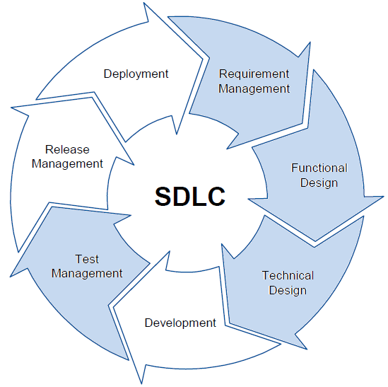

Need 3: Lifecycle Alignment
What about other life-cycles? A waterfall organization
Feasibility study
high phases
Requirements analysis&
specification
Design
Coding&Unit test
low phases
Integration&System test
Deployment
“Waterfall” Model
Maintenance

Slide 23



What is the difference between Waterfall, Agile and DevOps
What about other life-cycles? Agile development
Daily Scrum meeting
Agile Methods
24 Hours
Working/Product Sofware potentially shippable product increment
Product Backlog
Sprint
Backlog
2-4 Weeks
Sprint planning meeting

Slide 24
Waterfall vs. Agile vs. DevOps
Concerns | Waterfall | Agile | DevOps
Main Focus | Design and development | Design and development | Whole application life-cycle
Attention to Operation | Minimal or none | Minimal or none | Main concern
Role of Maintenance | Maintenance seen as a redevelopment phase | Maintenance seen as a redevelopment phase | Replaces a running system with a running system
Process Outcome | A packaged system ready to be deployed | Various intermediate demo versions of the system | A continuously updated running system
Quality Assurance | Testing typically performed toward the end of the process | Test-driven development | Test-driven development and monitoring-driven operation with feedback to Dev

Slide 25
Who focuses on DevOps (in some way)?
2014 State of DevOps Report, Puppet Labs (9200+ respondents)

Slide 26
Puppet Labs Findings and Survey recommendations
Clear correlation between high IT performance and strong business performance
Suggestions for improvement:
 | Practitioners | Managers
Cross-functional collaboration | Work with other teams Find ways to build empathy Make invisible work visible | Build trust Encourage practitioners to move between departments Facilitate collaboration
Climate of learning | Learn by sharing knowledge Always bring back what you learned Prepare for postmortems | Create and acquire training budget Create a climate of learning and sharing Make it safe to fail
Tools | Automate the things that are painful | Make sure your team chooses the tools Make monitoring a priority

Slide 27


High Performance DevOps Companies Achieve…
46x Deployment
Frequency
2,555x Faster Lead
Time For Changes
Faster
Time to Market
DevOps
$
Increased
Revenue
7x Lower Change
Failure Rate
2,604x Faster Mean
Time to Recover
Source: 2018 Accelerate: State of DevOps: Strategies for a New Economy." N. Forsgren, J. Humble, G. Kim. DevOps Research and Assessment (DORA)

Slide 28
DevOps Organisational Changes
What to avoid: anti-patterns
Dev
Ops
Dev
DevOps
Ops
Separate Silos
Separate DevOps Silo
Dev
DevOps
Ops
We don’t need Ops
From M. Skelton. What Team Structure is Right for DevOps to Flourish? 2013 http://blog.matthewskelton.net/2013/10/22/what-team-structure-is-right-for-devops-to-flourish/
http://web.devopstopologies.com

Slide 29
DevOps Organisational Changes
What to do: adoption patterns
Dev
Ops
Dev
Ops
Dev
DevOps
Ops
Smooth collaboration
Fully Embedded
Infrastructure as a Service
Dev
DevOps
Ops
Dev
DevOps
Ops
DevOps as a Service
Temporary DevOps Team
From M. Skelton. What Team Structure is Right for DevOps to Flourish? 2013 http://blog.matthewskelton.net/2013/10/22/what-team-structure-is-right-for-devops-to-flourish/
http://web.devopstopologies.com

Slide 30
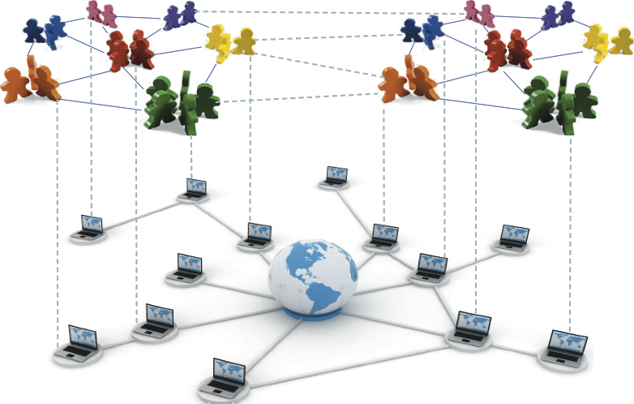
Need 3: Clearing The Way Towards DevOps
Find and mitigate Organizational/Social Barriers to DevOps
Study Organizational and Social Structure
Isolate Barriers, e.g. silo-effects
Employ Mitigations, e.g. influence with new policies and org. culture!
“You can’t buy DevOps, its a community transition that cannot heed planning or off-the-shelf solutions” Todd Waits – DevOps Guru
“Organisational structure can turn out to be conflicting towards DevOps goals - if everyone is divided into very different groups, DevOps is impossible” Aaron Volkmann – DevOps Guru

Slide 31
When to focus on DevOps and why?
Numbers Overview (1/2)
DevOps Benefits
Benefit/Metric | Improvement
New software/services that would otherwise not be possible | 21%
A reduction in time spent fixing and maintaining applications | 21%
Increased collaboration between departments | 21%
An increase in revenue | 19%
Improved quality and performance of deployed applications | 19%
A reduction in spend on development, testing or operations | 19%
Software/Services made available across more platforms | 18%
Reduced time-to-market for software/services | 18%
Increased numbers of customers using software/services | 18%
Fewer employees working on developing and deployng software | 18%
Increased frequency of deployments of software/services | 15%
1.256 respondents
Taken by CA technologies report: DevOps: The Worst-Kept Secret to Winning in the Application Economy - 2013

Slide 32
When to focus on DevOps and why?
Numbers Overview (2/2)
1.256 respondents
Taken by CA technologies report: DevOps: The Worst-Kept Secret to Winning in the Application Economy - 2013

Slide 33
DevOps Maintenance
- Continuous Architecting
Def. “architect for test, build and deploy, take quality attributes into account, take advantage of feedback from runtime” [1]
- Continuous Integration
Def. “merge all developer work-copies to a shared mainline frequently” [4]
Examples. Apache Jenkins, Hudson, etc.
- Continuous Testing
Image by Kharnagy (Own work) [CC BY-SA 4.0 (http://creativecommons.org/licenses/by-sa/4.0)], via Wikimedia Commons
Def. “run tests as part the build pipeline so that every check-in and deployment is validated” [3]
Examples. Selenium+GitHub+LI-API, etc.

Slide 34
1.Configuration Management
2. Server Provisioning
5. Self-Adaptation
3. Application Deployment
4. Monitoring

Slide 35
Part 2: DevOps Pipelines Maintenance and Evolution Explained!

Slide 36
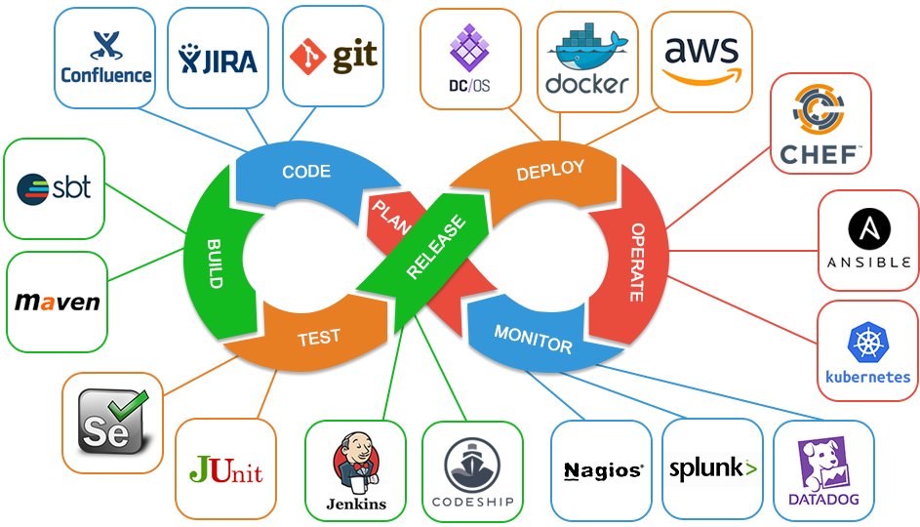

Slide 37
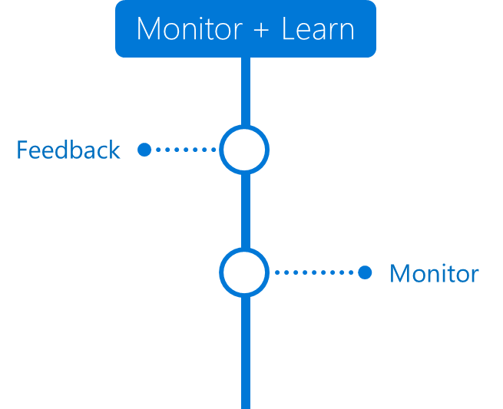
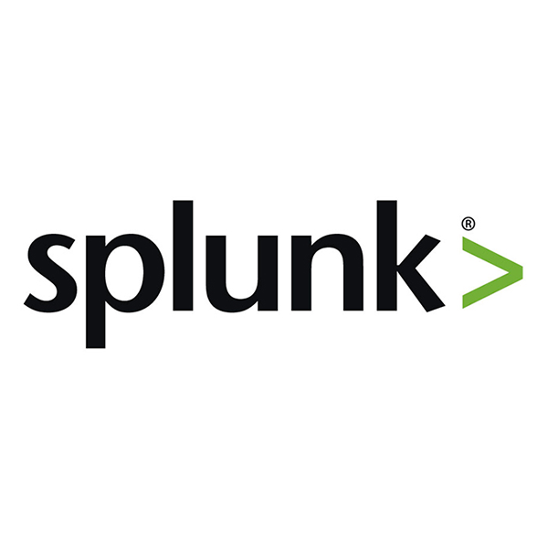


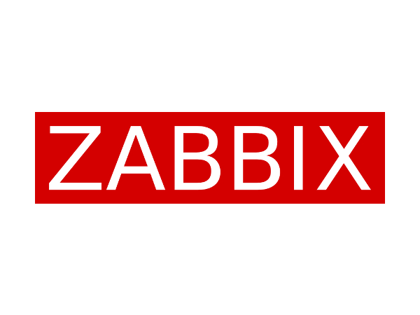
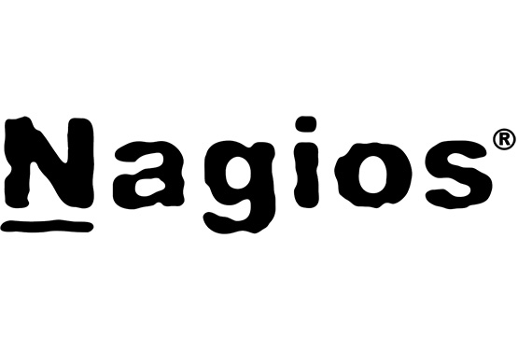
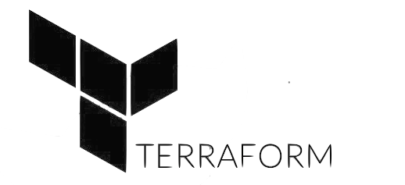
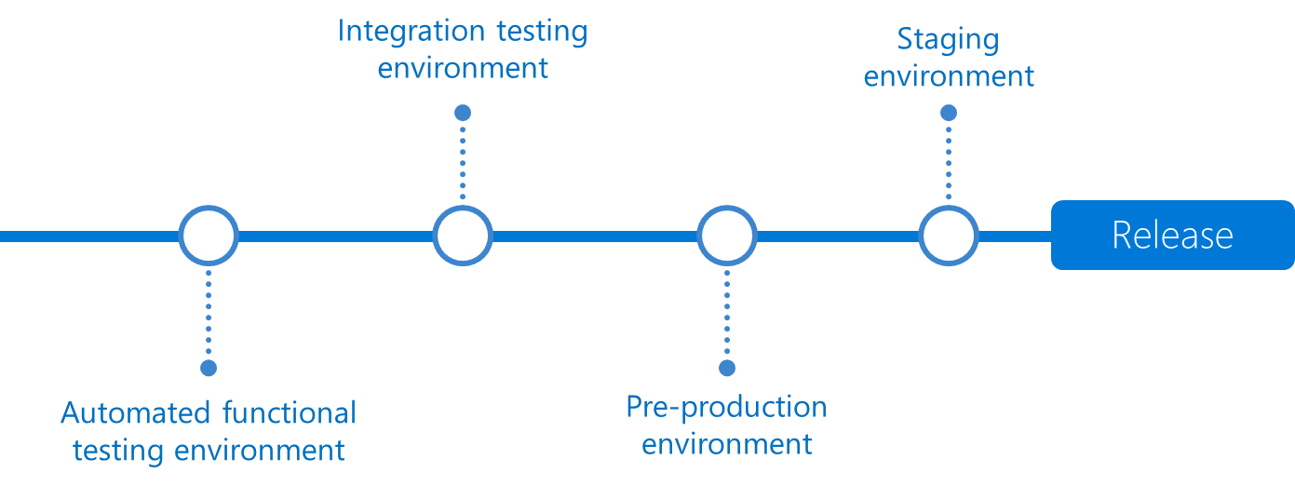
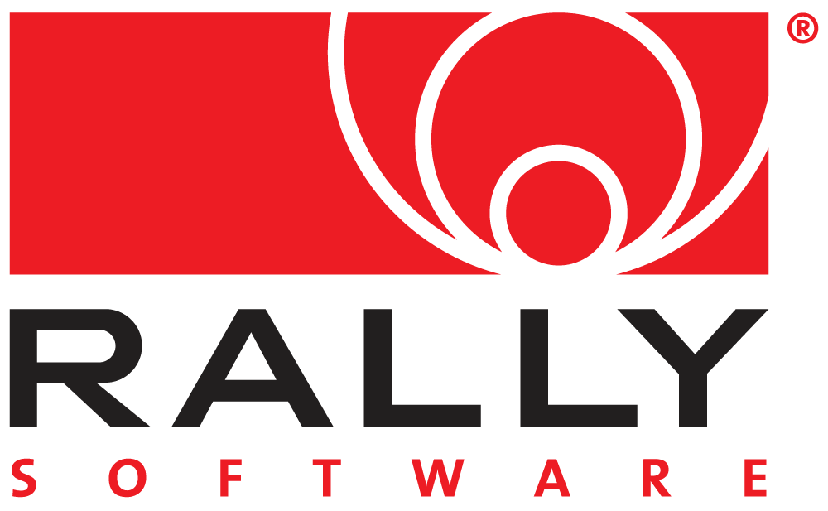


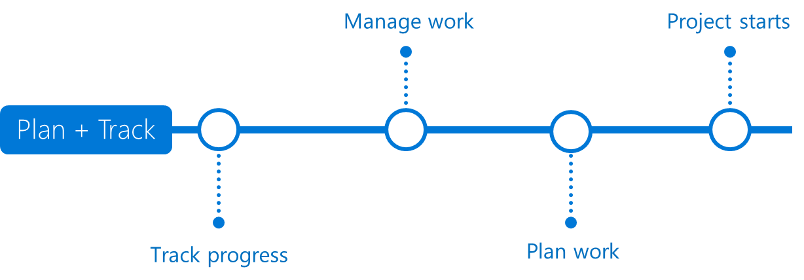


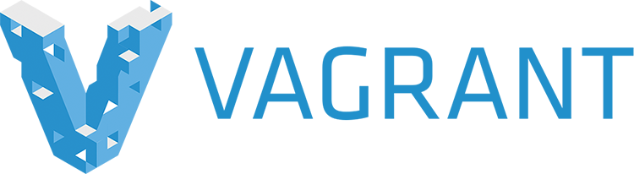


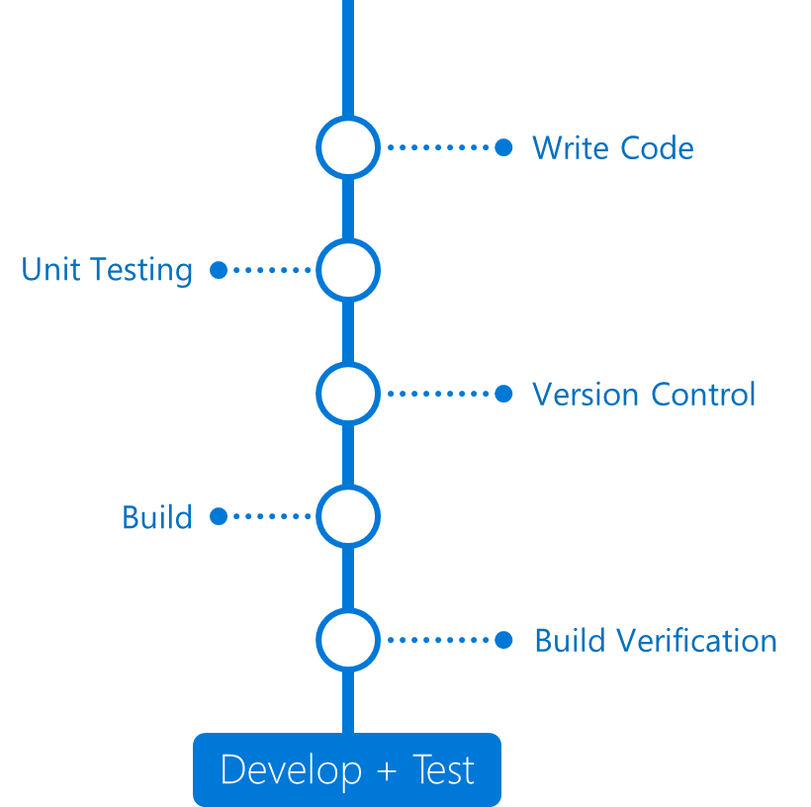

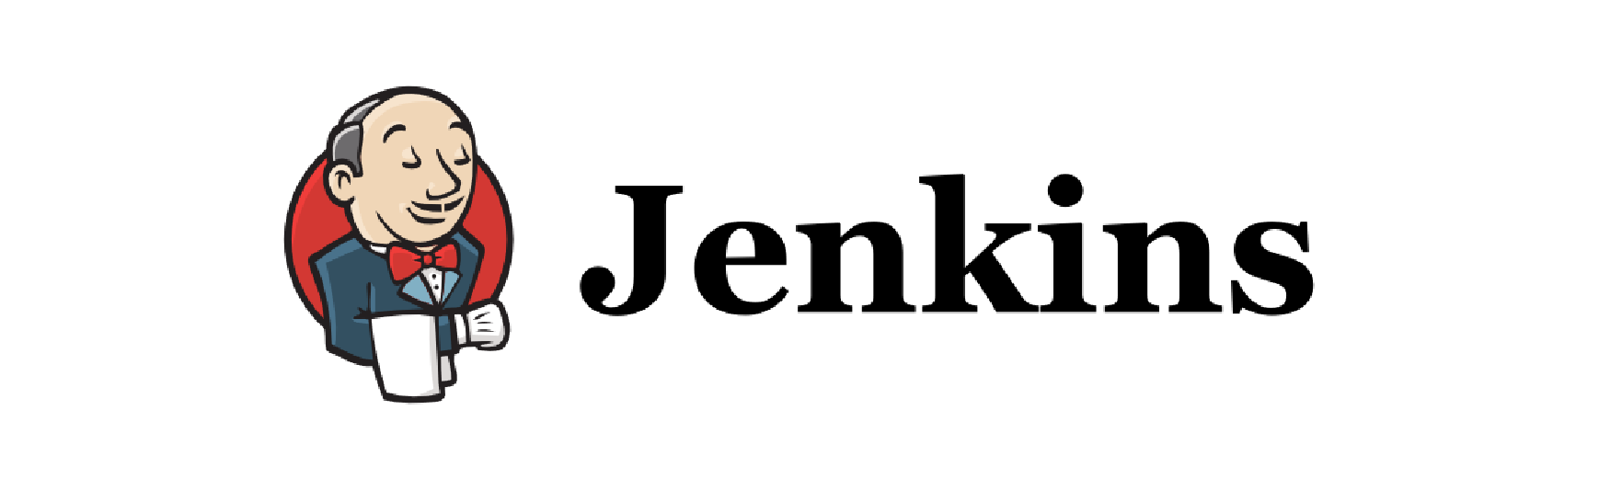

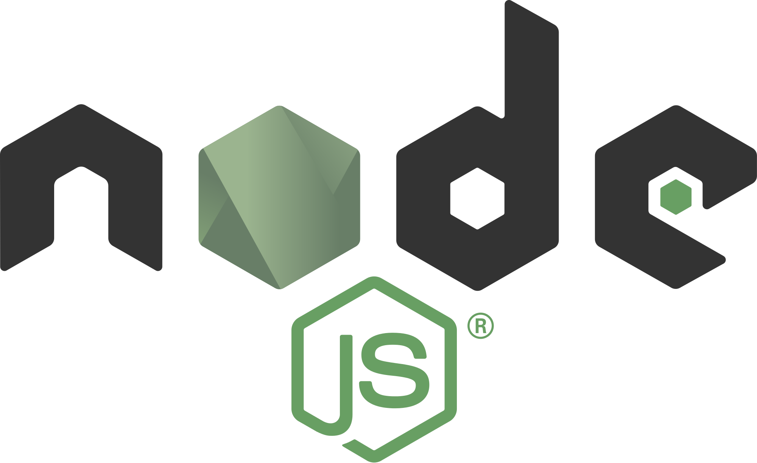
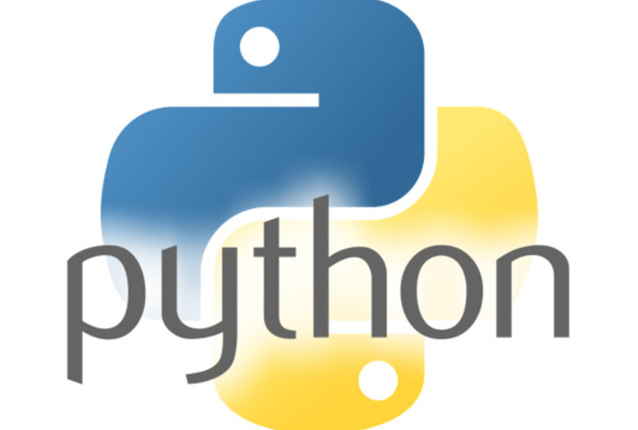

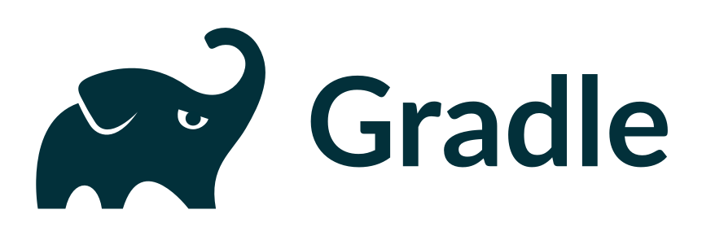

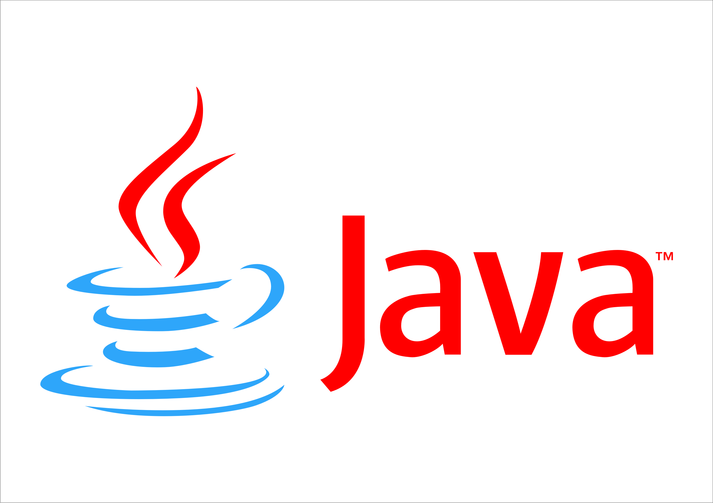
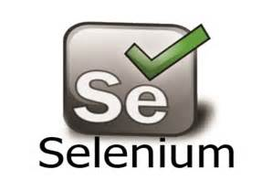
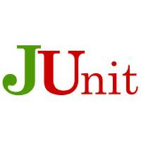
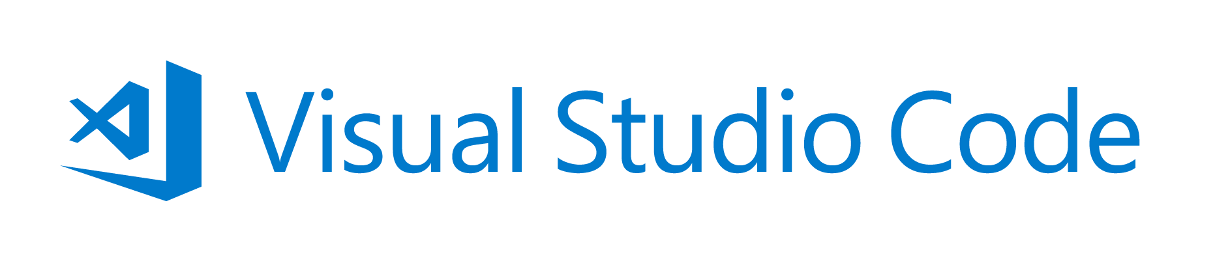
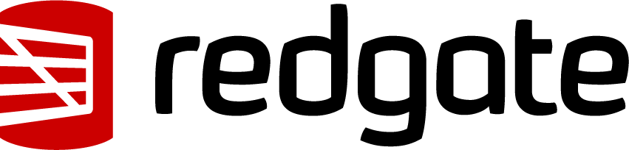
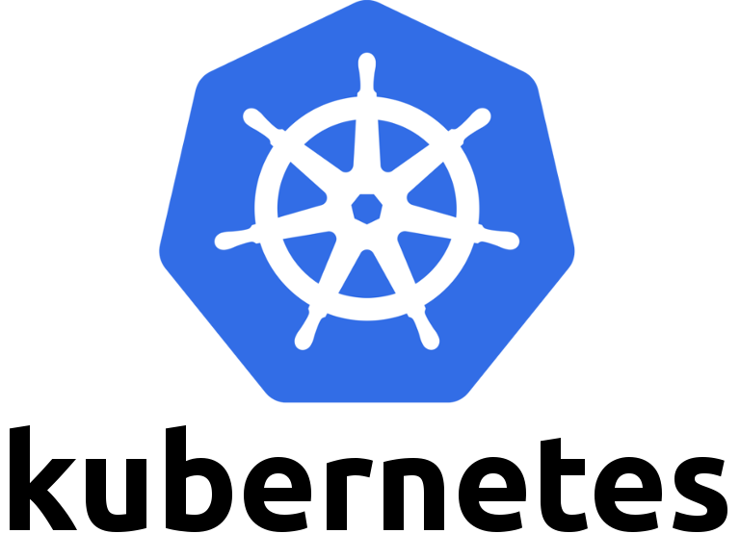





Application Insights
Visual Studio

Slide 38
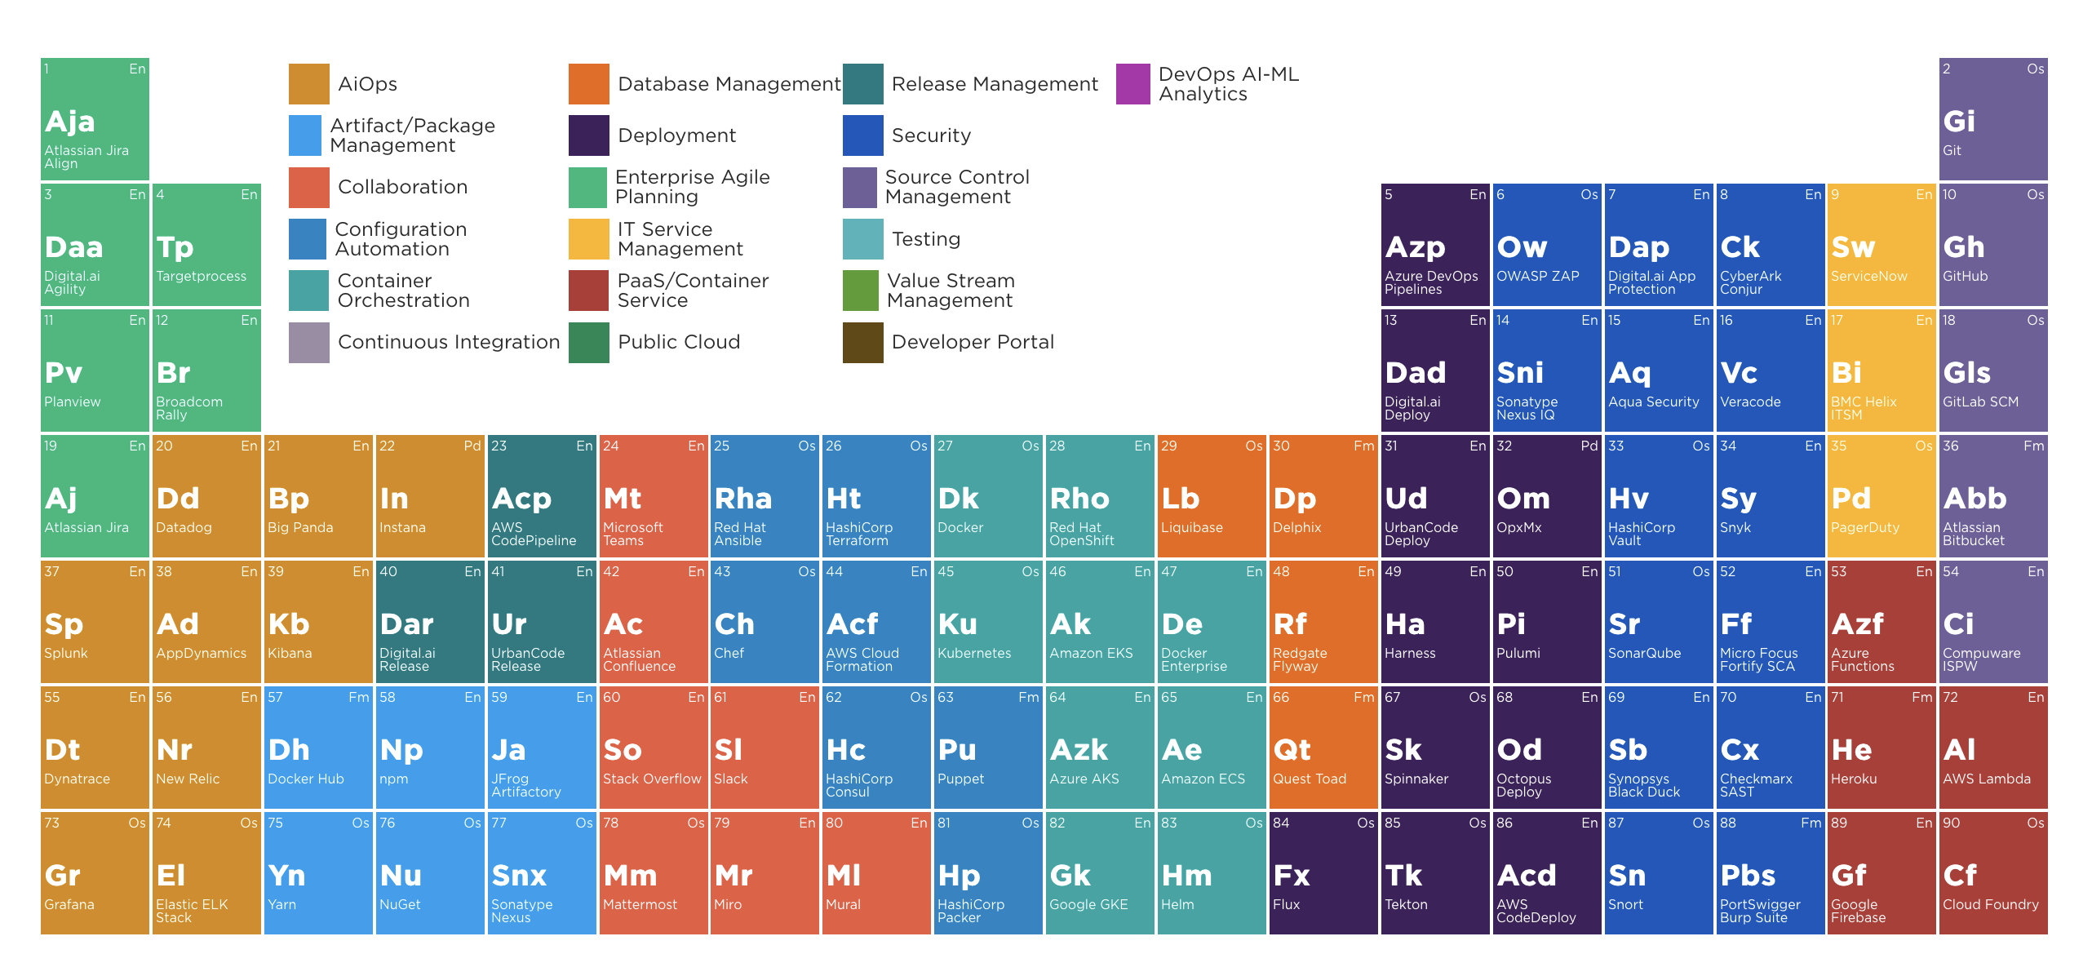
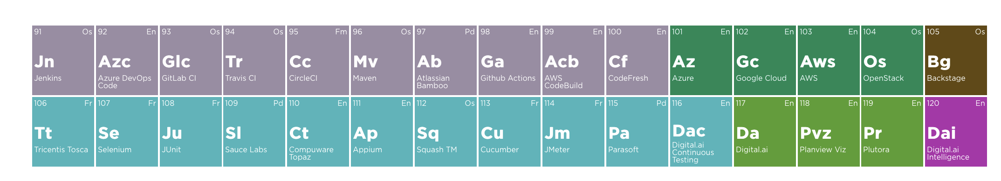
Digital.ai DevOps Periodic Table
Notes:
https://digital.ai/learn/devsecops-periodic-table/

Slide 39
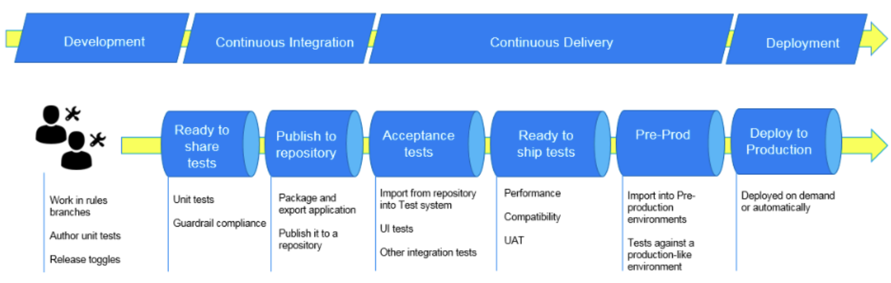
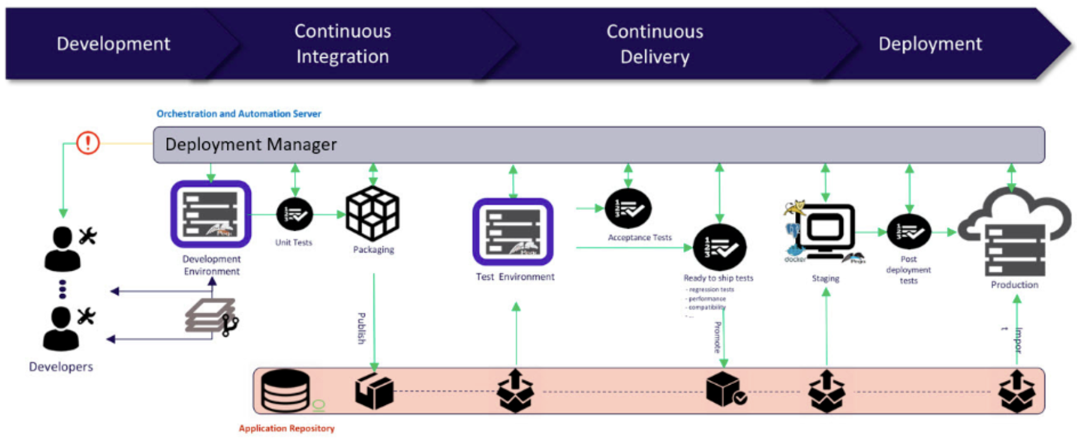
Notes:
Take stuff from here
https://github.com/rfennell/Presentations/blob/main/Introduction%20to%20DevOps%20with%20Azure%20DevOps%20Pipelines.pptx

Slide 40
What are GitHub Actions?

Slide 41
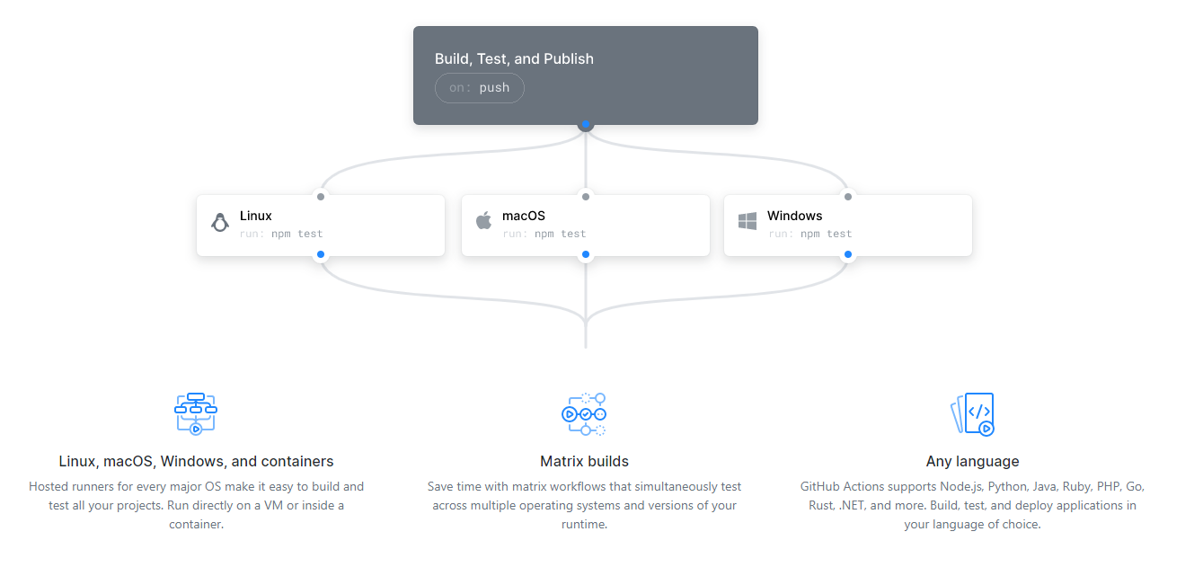
Run a workflow on any GitHub event
Notes:
A means to do CI/CD inside the GitHub experience.
For those familiar with Azure DevOps pipeline you will see known concepts, but this is all new language and action wise
Linux, macOS, Windows, and containers
Matrix builds
Any language

Slide 42
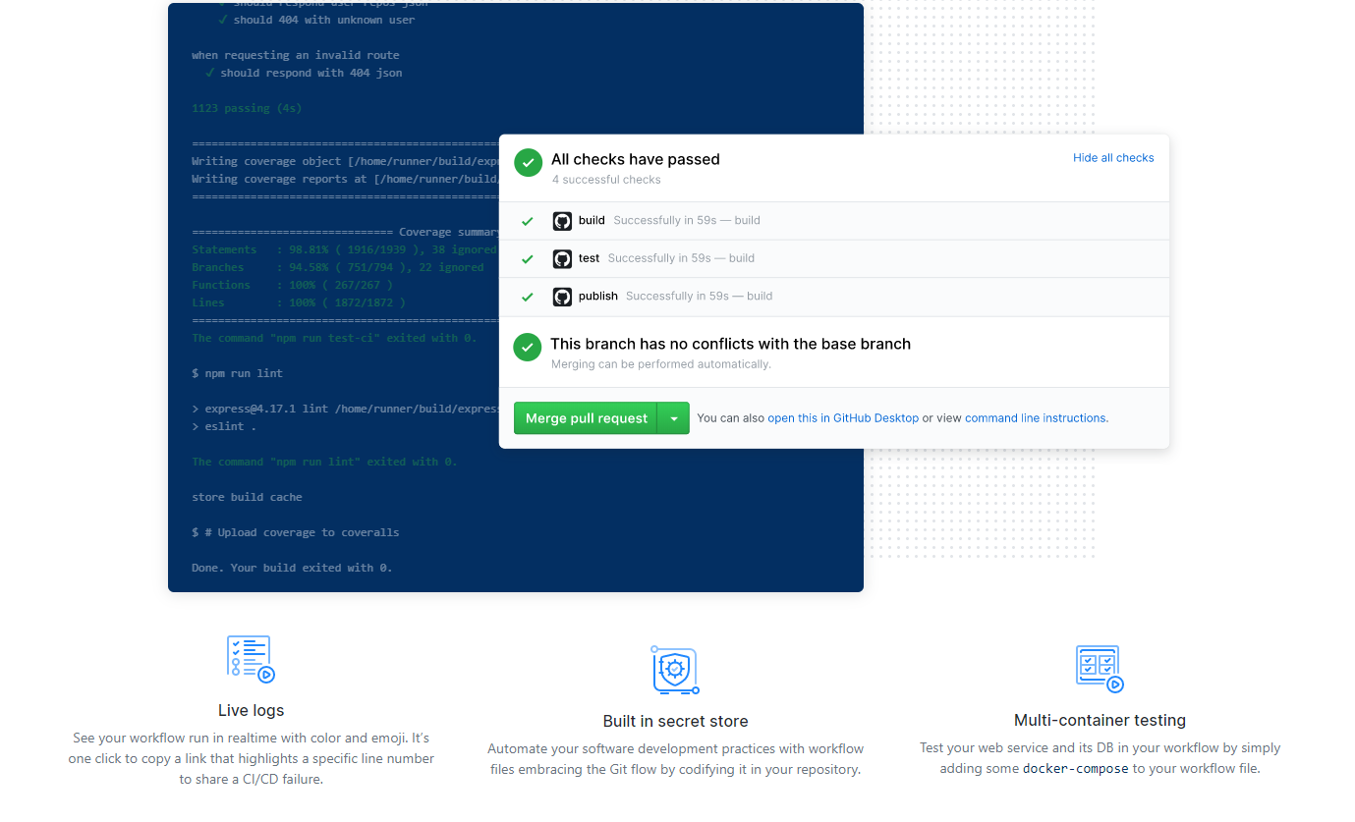
Built to Scale
Notes:
Live Logs
Built in secret store
Multi-container testing

Slide 43
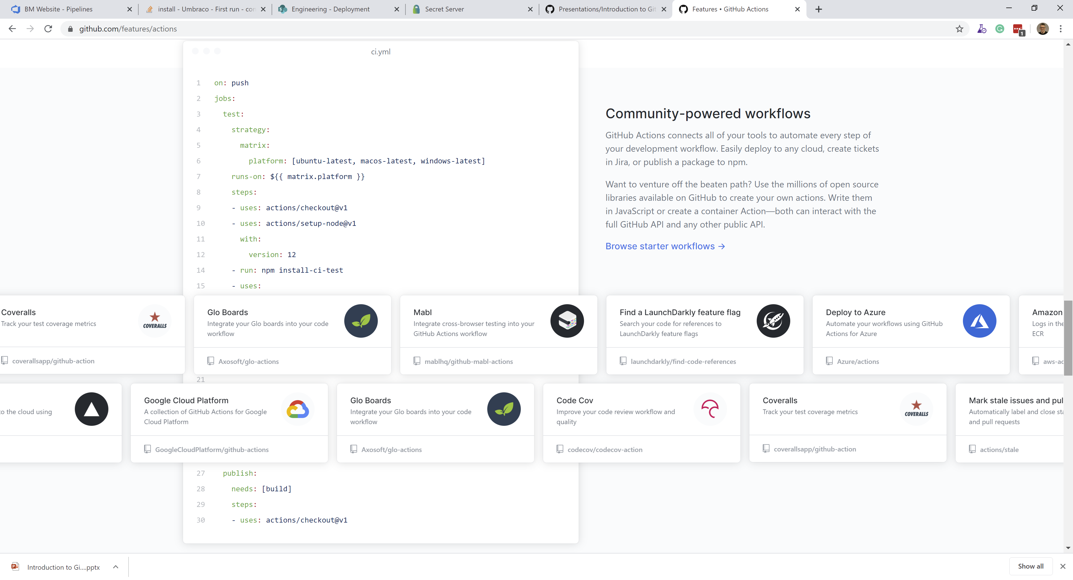
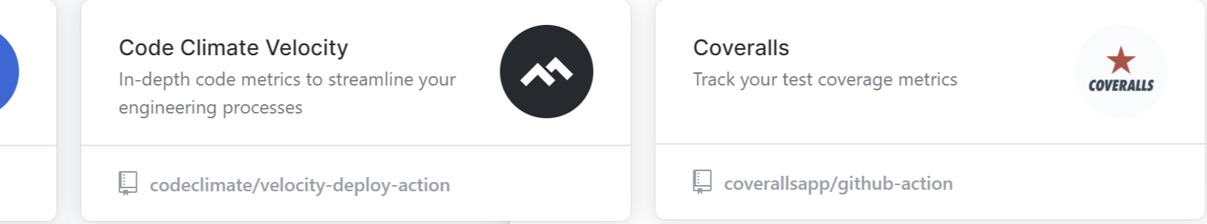
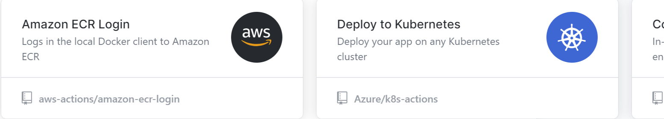
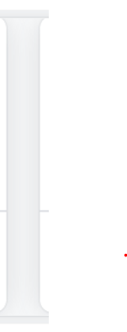
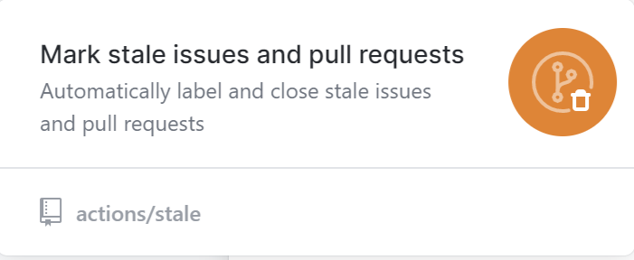
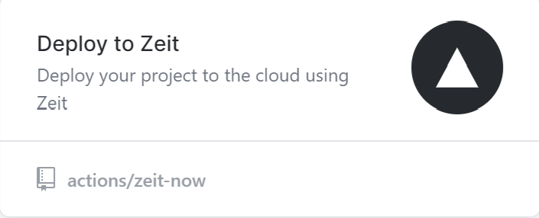
Community-powered workflows
Notes:
Community-powered workflows
GitHub Actions connects all of your tools to automate every step of your development workflow. Easily deploy to any cloud, create tickets in Jira, or publish a package to npm.
Want to venture off the beaten path? Use the millions of open source libraries available on GitHub to create your own actions. Write them in JavaScript or create a container Action—both can interact with the full GitHub API and any other public API.

Slide 44
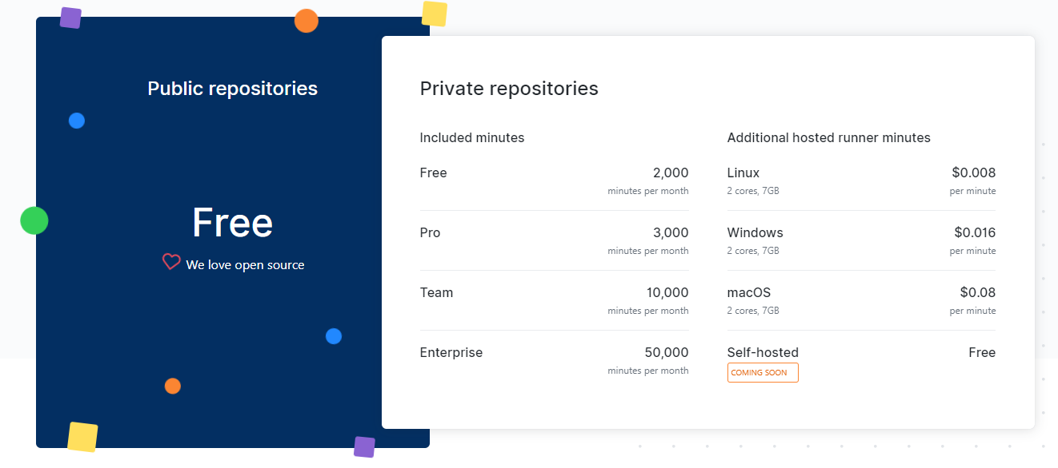
Simple, pay-as-you-go pricing

Slide 45
~Demo: Your first Workflow
Notes:
Add a workflow to a hello world node app
When triggered

Slide 46
A Sample Workflow
on:
push:
branches:
- master
jobs:
build-and-deploy:
name: Build and Deploy
runs-on: ${{ matrix.os }}
strategy:
matrix:
node_version: ['8', '10', '12']
os: [ubuntu-latest, windows-latest, macOS-latest]
steps:
- uses: actions/checkout@v2
- name: Use Node.js ${{ env.NODE_VERSION }}
uses: actions/setup-node@v1
with:
node-version: ${{ env.NODE_VERSION }}
- name: npm install, build, and test
run: |
npm install
npm run build --if-present
npm run test --if-present
What event triggers the workflow?
Where does it run?
What gets run?
Notes:
Not limited to Git operations, also webhooks, basically anything on GitHub

Slide 47
How do I write my own Custom Action?

Slide 48
Why might you want a custom action?
Control over logical flow
Use of custom tools not present on the agent
Aid management of complexity
Code reuse
Notes:
Control over logical flow
Wrapper loads of command
Use of custom tools not present on the agent
Avoid the need to install something, or use a language not present
Aid management of complexity
Related to both of the about
Code reuse
Avoids need to cut and past blocl

Slide 49
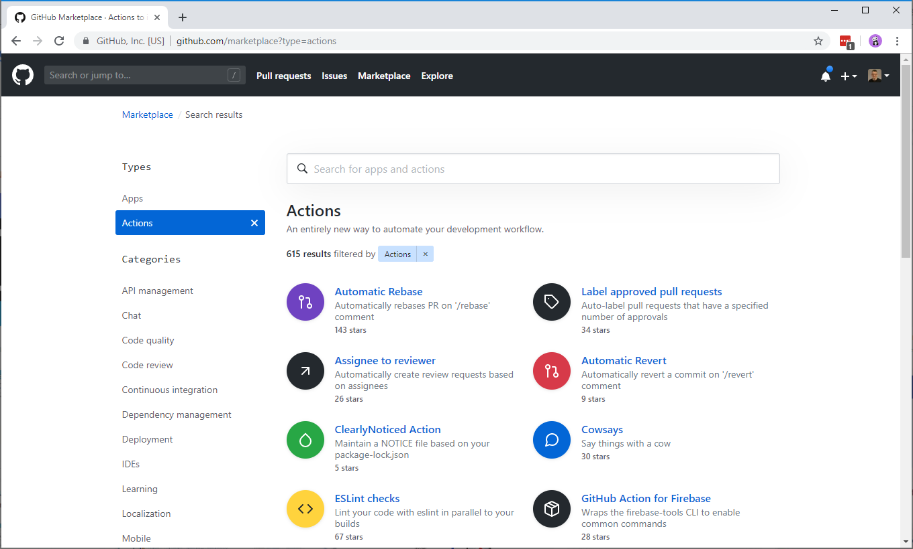
Before you start, remember the Marketplace

Slide 50

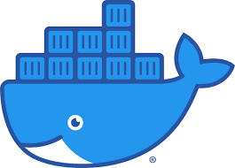
What do I write my action in?
JavaScript
Docker
Fast to load
Runs directly on Agent
SDK for Workflows API
Templates available
But requires correct setup
Flexible, any tools any language
Built at runtime or loaded from Docker Registry
Consistent results
Slower to start

Slide 51
Anatomy of an Action.yaml file
name: 'Apply Version to JSON file'
description: 'Adds a version number to a field in a JSON file'
author: 'Richard Fennell'
inputs:
Path:
description: 'Source folder Filter (folder under GITHUB_WORKSPACE)'
default: ''
required: false
VersionNumber:
description: 'Version Number'
default: ''
required: true
outputs:
FileUpdated:
description: 'The name of the file updated'
runs:
using: 'node12'
main: 'lib/main.js'
branding:
icon: 'file-text'
color: 'green'
runs:
using: ’docker'
main: ’docker://image:tag'
runs:
using: ’docker'
main: ’dockerfile'
Notes:
A metadata file called either action.yml or action.yaml that defines
The inputs
The outputs
Main entrypoint for your action.

Slide 52
But I have some custom Azure DevOps Pipeline Tasks. Can I reuse them?

Slide 53
What is a good candidate?
Should be written in Node.JS
Can’t make use of Azure DevOps specific APIs
Must do something that is useful in GitHub workflows
Notes:
Of course you can port other languages
Docker opens up interesting opportunities

Slide 54
How did I write my own Custom Action?
Create a new repo from the template generator
https://github.com/actions/typescript-action
Copied in my task code into the repo bit by bit
Removed any Azure DevOps specific code that was not needed
Swapped the references to “vsts-task-lib/task” to “@actions/core”
Swapped tests from Mocha/Chai to Jest
Added running of TSLint to the build process
Updated the action manifest to expose parameters
Notes:
Create a new repo from https://github.com/actions/typescript-action
Copied in my task code into the repo bit by bit
Renamed my entry ApplyVersionToJSONFile.ts file to main.ts to keep inline with the template standard
Copied over the AppyVersionToJSONFuncitons.js
I removed any Azure DevOps specific code that was not needed.
In both files swapped the references to “vsts-task-lib/task” to “@actions/core” and update the related function calls to use
core.getInput()
core.debug()
core.warning()
core.SetFailed()

Slide 55
Adding a Release Branch
# comment out in distribution branches
# node_modules/
$ git checkout -b releases/v1
$ npm prune --production
$ git add node_modules
$ git commit -a -m "prod dependencies"
$ git push origin releases/v1
Notes:
As the scripts run from the repo needs the dependencies
This is a difference from Azure DevOps

Slide 56
Versioning your Action Updates
branch: master
master
fix issue from testing
fix bug
merge or rebase
branch: releases/v1
create release + tag: 1.0.1 tag: v1
merge or rebase
create release + tag: 1.0.2 move tag: v1
releases/v1
Check-in prod dependencies Test E2E
test E2E referencing releases/v1 branch ‘latest’ unreleased
Based on https://github.com/actions/toolkit/blob/master/docs/action-versioning.md

Slide 57
How to use your action in a workflow?
steps:
- uses: ./ # Uses a private action in the root directory of workflow repo
- uses: rfennell/JSONFileVersioner@74bc508 # a specific commit of a public action
- uses: rfennell/JSONFileVersioner@master # a branch of a public action
- uses: rfennell/JSONFileVersioner@v1.0.1 # the version of a release of a public action
- uses: rfennell/JSONFileVersioner@v1 # the major version of a release of a public action

Slide 58
Finally add it to the GitHub Marketplace
In your GitHub repo create a new draft release
Select ‘Publish to Marketplace’
Fix any errors, usually by checking in or editing files
Choose categories
Pick the tag that points to version to release
Click Publish release

Slide 59
Recap: an end-2-end CI/CD Pipeline
Let's assume the application is a containerized web app hosted on a cloud platform (e.g., AWS, GCP, or Azure).
The CI/CD pipeline will include the following components:
Source Code Repository: GitHub
CI/CD Tool: Jenkins or GitHub Actions
Containerization: Docker
Orchestration: Kubernetes (K8s)
Deployment: Cloud Platform (e.g., AWS EKS for Kubernetes)

Slide 60
Setup Jenkins as CI/CD Tool
Install Jenkins: Install Jenkins on a server or use Jenkins as a service.
Install Plugins: Install plugins required for integration with GitHub, Docker, and Kubernetes, like the Git plugin, Docker, and Kubernetes plugin.
Configure Credentials: Add GitHub credentials in Jenkins for repository access and Docker registry credentials for pushing Docker images.

Slide 61
Configure Jenkins Pipeline (Jenkinsfile)
Create a Jenkinsfile: Define the pipeline in a Jenkinsfile stored in the repository root. The pipeline should have stages like:
Checkout: Clone the latest code from GitHub.
Build: Build the Docker image for the application.
Test: Run unit and integration tests.
Publish: Push the Docker image to a registry.
Deploy: Deploy the application to Kubernetes.

Slide 62
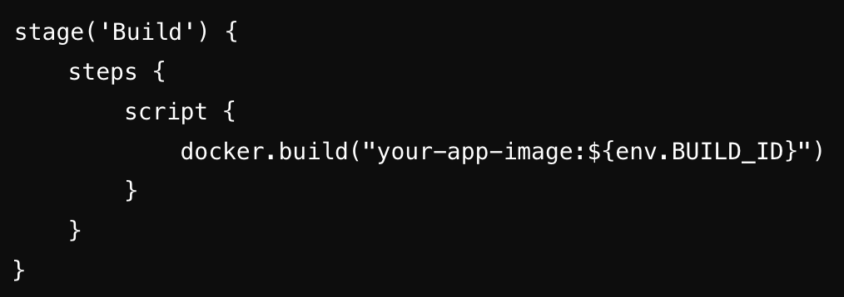
Build the Docker Image (Build Stage)
Define a Dockerfile in your project repository to containerize the application.
In the Jenkinsfile, add the build stage:

Slide 63
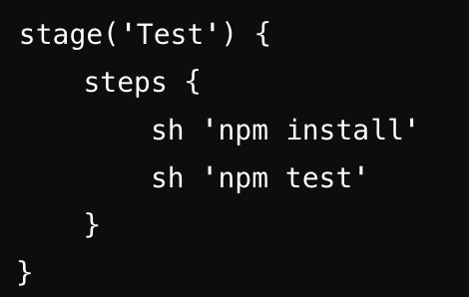
Run Tests (Test Stage)
In the Jenkinsfile, add a test stage to run unit and integration tests:

Slide 64
Publish Docker Image to Registry (Publish Stage)
After passing tests, publish the Docker image to a registry (e.g., Docker Hub, AWS ECR).
In the Jenkinsfile, add:
stage('Publish') {
steps {
script {
docker.withRegistry('https://registry.hub.docker.com', 'docker-credentials') {
docker.image("your-app-image:${env.BUILD_ID}").push()
}
}
}
}

Slide 65
Deploy to Kubernetes (Deploy Stage)
Kubernetes Manifest: Create YAML files for deployment and services in the k8s/ directory.
Kubernetes Plugin: Ensure Jenkins has access to your Kubernetes cluster.
In the Jenkinsfile, add:
stage('Deploy') {
steps {
script {
kubernetesDeploy(kubeconfigId: 'kubeconfig', configs: 'k8s/deployment.yaml')
}
}
}

Slide 66
Summary
GitHub Actions are a new alternative for CI/CD
You now don’t have to leave GitHub or provision other resources
They are free for OSS and pay-per-minute for private repo
They are not as rich in features as Azure DevOps Pipelines, yet…
Also, remember they are not limited to CI/CD
They can trigger a workflow on any GitHub event

Slide 67
Part 3: Industry Drivers for Sw. Evolution of DevOps Pipelines

Slide 68

1. Source Control
Notes:
Your safety net
All tried a test/refactor and messed it up and need to go back
Today you would consider this ‘table stakes’
But not always present (IT and scripts)
True to say Git is now the defacto standard irrespective of provider
But it does everyone know how to use the tools (
True in Git, maybe more than any other scc as there are less options?
This is particularly true for students new hire – there is not much source control taught
Source Control if enabled can be part of protection from human error
Enforcing rules e.g. branching/merge – requiring pull requests – not a git feature but by providers
More of that later….

Slide 69

2. Work Tracking
Notes:
Does not have to be technology – but you need to know what to do and in what order
All systems trying to be as good as a postit notes
Good if it can be linked to source control for audit
This is where process come in
Waterfall vs Agile
Scrum
Kanban
Putting arguments side over process, all tend to stress
Short delivery cycles
Focused teams/delivery
Close relationship with client

Slide 70

3. Continuous Integration
Notes:
Build has always been important
Story me in 80s writing Pascal for HP Mini were doing night builds
One of the first appearances in Kent Beck in XP books of whole system
Today I would hope we do better
Make CI Heart beat of a project
Every commit (or at least PR) should be tested it can be build
THIS IS IRRESPECTIVE OF LANGUAGE
Just because you don’t need to compile do still Lint or equivalent
So much can be hung off this a team/project matures (we will keep coming back to it)

Slide 71

4. Continuous Delivery
Notes:
Defined types of CD
Continuous delivery automates deployment of a release to an environment for staging or testing
While continuous deployment automatically deploys every release through your pipeline (including testing) and to production. Continuous deployment is an extension of the continuous delivery concept
CD is enabled
By small releases
Feature flags help
Build trust on how you can release
Like CI it is a core technology that can have other items added into it

Slide 72

5. Infrastructure as Code
Notes:
A major barrier to innovation has always be time to provision hardware
The time form ‘loading dock to machine room’
Story – worked project to move updates measure in months to hours
Normally when we talk about IAC we are meaning with cloud
Where the rental model means it is easy to buy only what you use
Vendor agnostic like Teraform, or vendor ARM/Bicep
Should be able to ‘stamp’ out a complete instance of your system
Lint in CI
Deploy in CD
But if on prem still can use some of these technologies if running VMWare Hyper V
We use Lability to automated provision of complete enviroments on Hyper-V

Slide 73

6. Automated Testing
Notes:
Can be at any level from Unit to UX
Invest in the lowest level tests that work for your needs
Wire into CI and CD

Slide 74

7. Supply Chain Analysis
Notes:
Loads that can be done in CI/CD
Range of Tools
SonarCloud
Synk
GitHub Advanced Security
Vulnerabilities tracking
Dependabot

Slide 75

8. (auto-) Documentation
Notes:
Documentation can mean many thing.
The danger is it is an after thought
Need to make up to date and easy to consume (be in the right place)
Automate its product as part of CI/CD process
Use example of my extension

Slide 76

9. Exploration
Notes:
Core to agile process
Can try out any part of the system to improve it
Embrace your inner toddler
Story of how adding CI?CD makes exploration cheaper

Slide 77

10. Buy-in!
Notes:
Team and C level management

Slide 78
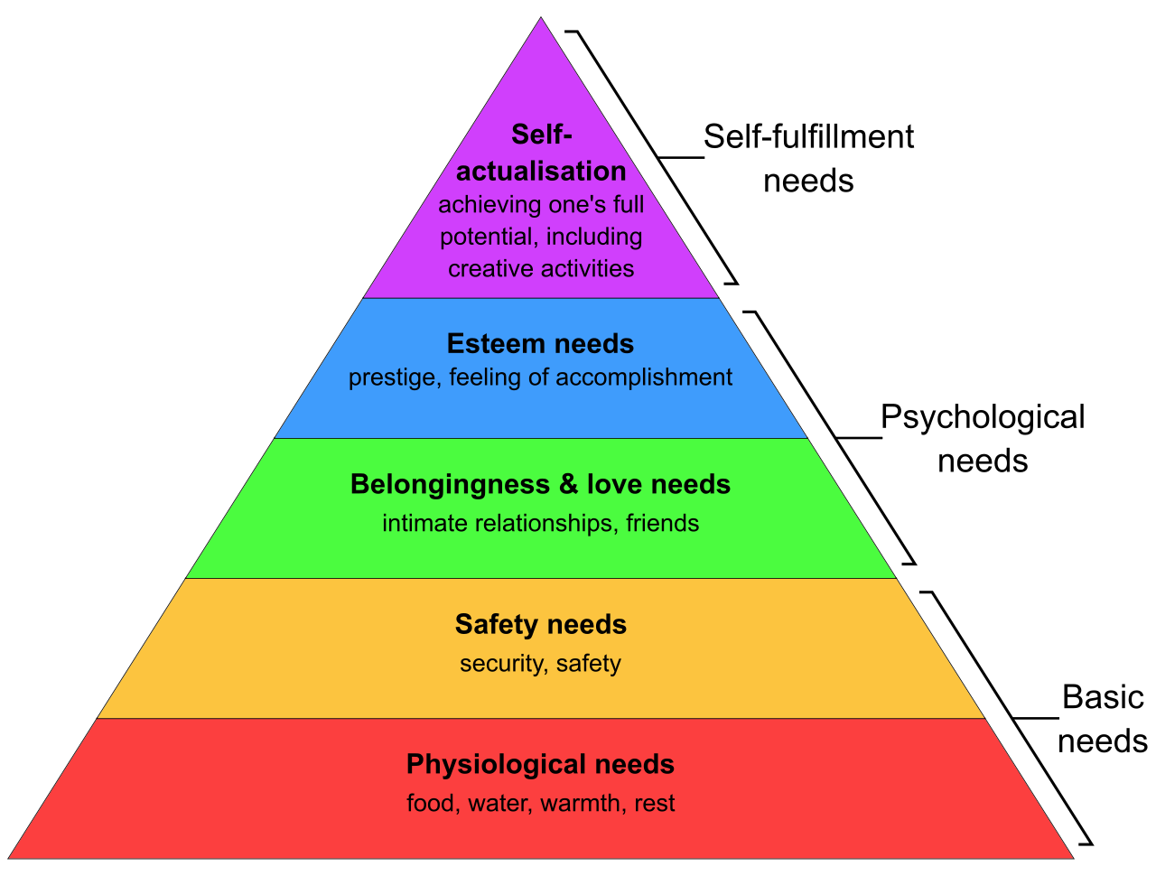
Maslow’s Hierarchy Of Needs
Notes:
Though can consider the items I have called table stakes – the lower level?
Maybe look at them as levels of maturity
There is a mapping but it is open to teams view as which is correct for them,

Slide 79
“ Culture Eats Strategy For Breakfast ”
Peter Drucker
Notes:
Supposedly said by Peter Drucker the management guru in 2006 (origin in dispute)
IBM, General Motors, and Procter & Gamble – basically created moder enterprise structures
Culture tends to comes first
No good being able to release each day, but only if management/business only allows quarterly
Looking from the other end Alistair Cockburn ‘Crystal Clear: A Human-Powered Methodology for Small Teams’ talks about a system needs to be Habitable
Sneak stuff in – was there a name for that

Slide 80

Questions?

Slide 81
Resources
There is an active community
https://github.community/t5/GitHub-Actions/bd-p/actions
And documentation at
https://help.github.com/en/categories/automating-your-workflow-with-github-actions
And a Pluralsight Course
‘Building Custom GitHub Actions’ By Enrico Campidoglio

